Slide 1
Different Blockchain Platfroms
Public Blockchains
Private Blockchains
Federated Blockchains or Consortium Blockchains
© 2018 Loui Mercieca. All rights reserved

Slide 2
Different Blockchain Platfroms
Public Blockchains
State of the art public Blockchain protocols based on Proof of Work (PoW) consensus algorithms are open source and not permissioned.
Anyone can participate, without permission.
Anyone can download the code and start running a public node on their local device, validating transactions in the network, thus participating in the consensus process – the process for determining what blocks get added to the chain and what the current state is.
Anyone in the world can send transactions through the network and expect to see them included in the blockchain if they are valid.
Anyone can read transaction on the public block explorer. Transactions are transparent, but anonymous/pseudonumous.
© 2018 Loui Mercieca. All rights reserved

Slide 3
Different Blockchain Platfroms
Public Blockchains
Bitcoin, Ethereum, Monero, Dash, Litecoin, Dodgecoin, etc.
Effects:
Potential to disrupt current business models through disintermediation.
No infrastructure costs: No need to maintain servers or system admins radically reduces the costs of creating and running decentralized applications (dApps).
© 2018 Loui Mercieca. All rights reserved

Slide 4
Different Blockchain Platfroms
Private Blockchains
Write permissions are kept centralized to one organization.
Read permissions may be public or restricted to an arbitrary extent.
Example applications include database management, auditing, etc.
Private blockchains are a way of taking advantage of blockchain technology by setting up groups and participants who can verify transactions internally.
This puts you at the risk of security breaches just like in a centralized system, as opposed to public blockchain secured by game theoretic incentive mechanisms.
private blockchains have their use case, especially when it comes to scalability and state compliance of data privacy rules and other regulatory issues.
© 2018 Loui Mercieca. All rights reserved

Slide 5
Different Blockchain Platfroms
Private Blockchains
MONAX & Multichain
Effects: (1)
reduces transaction costs and data redundancies and replaces legacy systems, simplifying document handling and getting rid of semi manual compliance mechanisms.
in that sense it can be seen as equivalent to SAP in the 1990’s: reduces costs, but not disruptive!
© 2018 Loui Mercieca. All rights reserved

Slide 6
Different Blockchain Platfroms
Federated Blockchains or Consortium Blockchains
Federated Blockchains operate under the leadership of a group.
As opposed to public Blockchains, they don’t allow any person with access to the Internet to participate in the process of verifying transactions.
Federated Blockchains are faster (higher scalability) and provide more transaction privacy.
Consortium blockchains are mostly used in the banking sector.
The consensus process is controlled by a pre-selected set of nodes; for example, one might imagine a consortium of 15 financial institutions, each of which operates a node and of which 10 must sign every block in order for the block to be valid.
The right to read the blockchain may be public, or restricted to the participants.
© 2018 Loui Mercieca. All rights reserved

Slide 7
Different Blockchain Platfroms
Federated Blockchains or Consortium Blockchains
Example: R3 (Banks), EWF (Energy), B3i (Insurance) , Corda
Effects: (1)
reduces transaction costs and data redundancies and replaces legacy systems, simplifying document handling and getting rid of semi manual compliance mechanisms.
in that sense it can be seen as equivalent to SAP in the 1990’s: reduces costs, but not disruptive!
© 2018 Loui Mercieca. All rights reserved

Slide 8
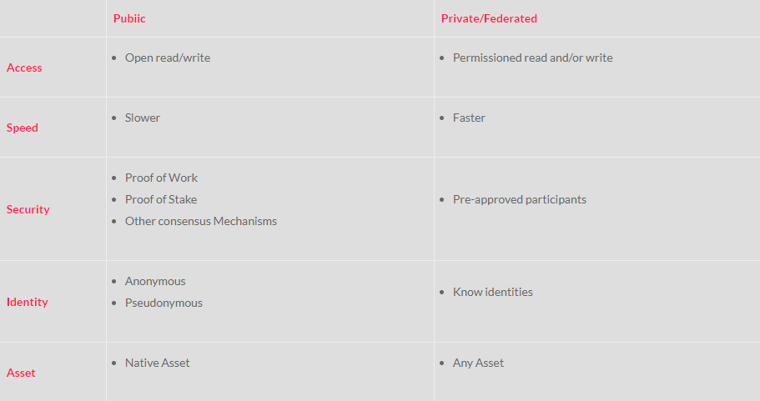
Different Blockchain Platfroms
Classification Schemes
Source: Chris Skinner’s Blog
© 2018 Loui Mercieca. All rights reserved

Slide 9
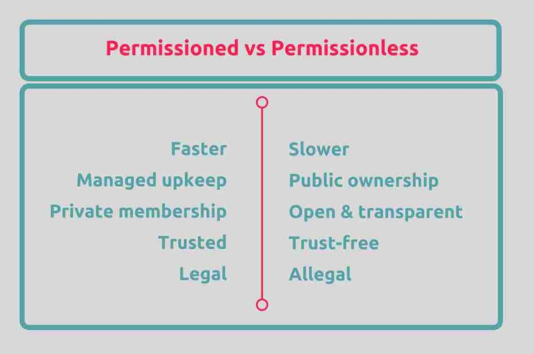
Different Blockchain Platfroms
Classification Schemes
Source: Gavin Wood (2016)
© 2018 Loui Mercieca. All rights reserved

Slide 10
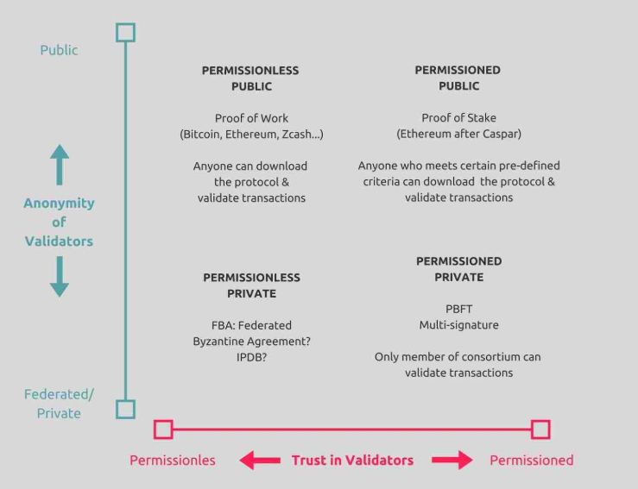
Different Blockchain Platfroms
Classification Schemes
Adapted and modified from: Pavel Kravchenko (2016)
© 2018 Loui Mercieca. All rights reserved

Slide 11
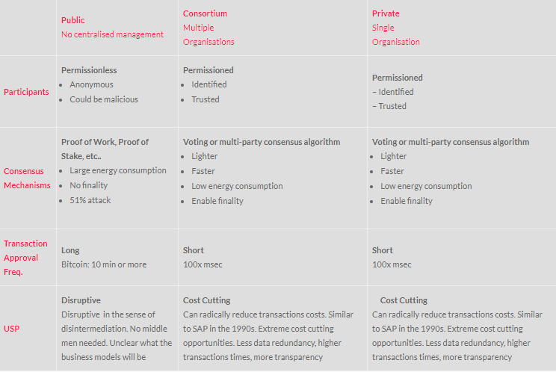
Different Blockchain Platfroms
Classification Schemes
© 2018 Loui Mercieca. All rights reserved

Slide 12
Different Blockchain Platfroms
Blockchain Implementation Solutions
There is a wide array of approaches to implementing Blockchain or other Distributed Ledger Technologies.
A diverse landscape of players has emerged, including software service providers that offer software capabilities on higher stack levels than the blockchain protocols themselves.
Each approach has its own merits and challenges.
© 2018 Loui Mercieca. All rights reserved

Slide 13
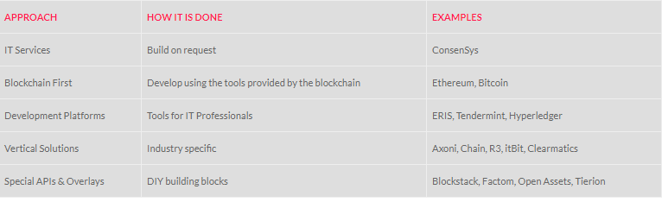
Different Blockchain Platfroms
Blockchain Implementation Solutions
© 2018 Loui Mercieca. All rights reserved

Slide 14
Different Blockchain Platfroms
Blockchain as a Service (BaaS)
Setting up an environment to test and research blockchain requires an ecosystem with multiple systems to be able to develop research and test.
The big players in the cloud industry like Amazon(AWS), Microsoft(Azure), IBM(BlueMix) have seen the potential benefits of offering blockchain services in the cloud and started providing some level of BaaS to their customers.
Users will benefit from not having to face the problem of configuring and setting up a working blockchain. Hardware investments won’t be needed as well.
Microsoft has partnered with ConsenSys to offer Ethereum Blockchain as a Service (EBaaS) on Microsoft Azure.
© 2018 Loui Mercieca. All rights reserved

Slide 15
Different Blockchain Platfroms
Blockchain as a Service (BaaS)
IBM(BueMix) has partnered with Hyperledger to offer BaaS to its customers.
Amazon announced they would be offering the service in collaboration with the Digital Currency Group.
Developers will have a single-click cloud-based blockchain developer environment, that will allow for rapid development of smart contracts.
Examples: Accenture, ConsenSys, Cognizant, Deloitte, IBM, PricewaterhouseCoopers (PWC), Ernst & Young.
© 2018 Loui Mercieca. All rights reserved

Slide 16
Different Blockchain Platfroms
Blockchain as a Service (BaaS)
IBM(BueMix) has partnered with Hyperledger to offer BaaS to its customers.
Amazon announced they would be offering the service in collaboration with the Digital Currency Group.
Developers will have a single-click cloud-based blockchain developer environment, that will allow for rapid development of smart contracts.
Examples: Accenture, ConsenSys, Cognizant, Deloitte, IBM, PricewaterhouseCoopers (PWC), Ernst & Young.
© 2018 Loui Mercieca. All rights reserved

Slide 17
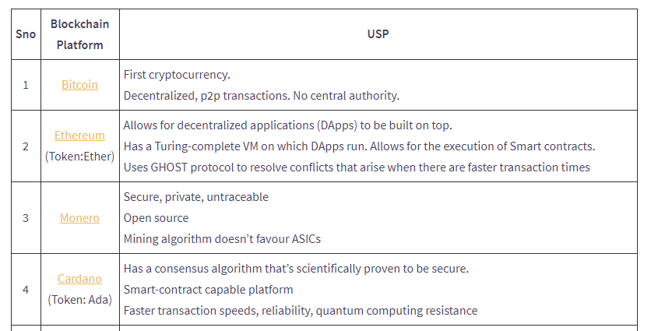
Different Blockchain Platfroms
Features of various Blockchains: A Comparison
© 2018 Loui Mercieca. All rights reserved

Slide 18
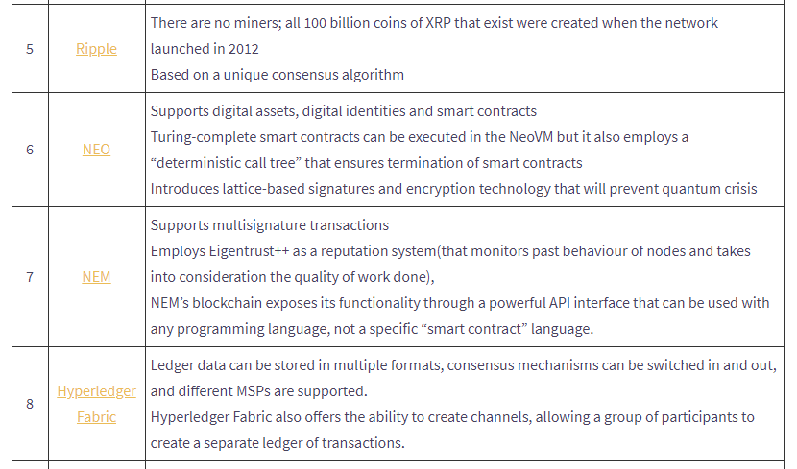
Different Blockchain Platfroms
Features of various Blockchains: A Comparison
© 2018 Loui Mercieca. All rights reserved

Slide 19
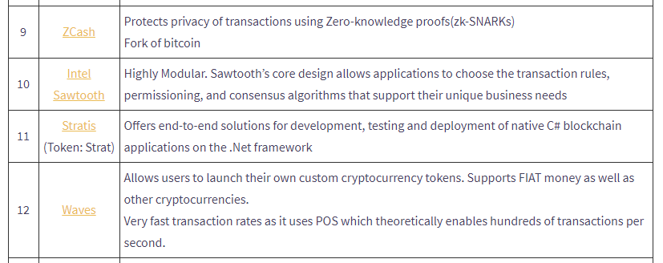
Different Blockchain Platfroms
Features of various Blockchains: A Comparison
© 2018 Loui Mercieca. All rights reserved

Slide 20
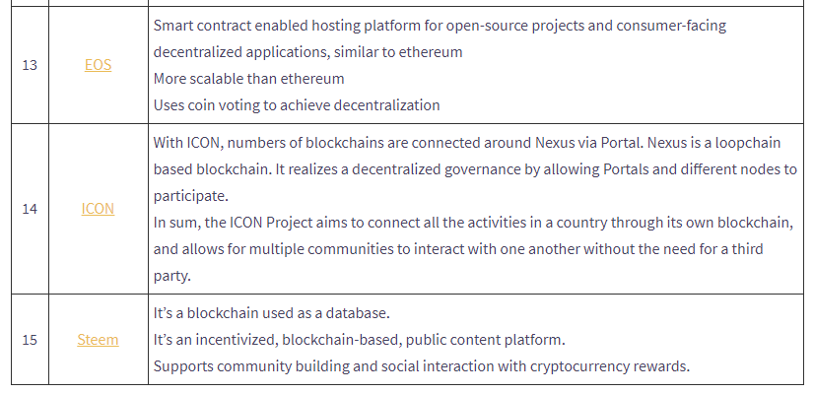
Different Blockchain Platfroms
Features of various Blockchains: A Comparison
© 2018 Loui Mercieca. All rights reserved

Slide 21
Different Blockchain Platfroms
Features of various Blockchains: A Comparison
Platfrom | Introduced | Permissioning and development | Applications | Consensus algorithm
Bitcoin | Jan-09 | Permissionless | Cryptocurrency | Proof of work
 |  | Open source
Ethereum | Jul-15 | Permissionless | DAPPs | Proof of work
(Token:Ether) |  | Open source
Monero | Apr-14 | Permissionless | Digital currency | Cryptonight Proof of work Hash algorithm
 |  | Open source
Cardano | 2015 | Permissioned/Permissionless | Digital diplomas, cryptocurrency | Ouroboros Proof of Stake algorithm
(Token: Ada) |  | Open source
Ripple | 2012 | Semi-permissioned | help settle cross-border payments | Ripple Protocol Consensus Algorithm (RPCA)
 |  | Open source | faster and more cheaply | based on a voting system where votes from nodes
 |  |  |  | in each node’s unique node list (trusted validators) is taken
 |  |  |  | into consideration for a node to decide on the next block
 |  |  |  | in the blockchain.
NEO | 2014 | Permissioned | Asset record keeping | delegated Byzantine Fault Tolerance (dBFT)
 |  | Open source
NEM | 2015 | Permissioned | Automatic accounting, KYC, | Proof of Importance
 |  | Open source | Logistics, Voting
Hyperledger Fabric | Dec-15 | Permissioned or permissionless | Used to create DApps | Consensus algorithms can be switched in and out
 |  | Open source
© 2018 Loui Mercieca. All rights reserved

Slide 22
Different Blockchain Platfroms
Features of various Blockchains: A Comparison
Platfrom | Introduced | Permissioning and development | Applications | Consensus algorithm
ZCash | 2016 | Permissionless | Cryptocurrency | Proof of work
 |  | Open source
Intel Sawtooth | 2014 | Permissioned or permissionless | For enterprise use | No particular consensus algorithm.
 |  | Open source |  | Eg: Sawtooth Lake uses something
 |  |  |  | called Proof of Elapsed Time (PoET)
Stratis | 2016 | Permissioned | Identity management, | Proof of stake
(Token: Strat) |  | Open source | supply chain management
Waves | 2016 | Permissionless | Transfer custom tokens | Proof of stake
 |  | Open source | from person to person
EOS | 2017 | Permissioned | DApps | delegated Proof of Stake
 |  | Open source
ICON | 2017 | Permissioned | Interconnect various blockchain communities | Loopchain Fault Tolerance(LFT)
 |  | Open source
Steem | 2017 | Permissioned | public content platform | Delegated Proof of Stake
 |  | Open source
© 2018 Loui Mercieca. All rights reserved

